Slide 1
Spark SQL - DataFrame
Pravin Y Pawar

Slide 2
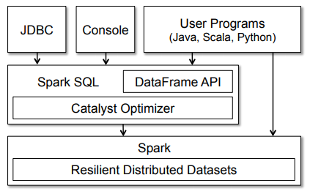
Spark SQL Architecture

Slide 3
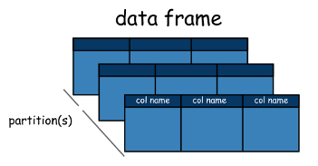

DataFrames
Is very powerful and allows users to finally intermix procedural and relational code!
Advanced functions like UDFs (user-defined functions) can also be exposed in SQL
Is basically a distributed collection of rows (row types) with the same schema
Basically a Spark Dataset organized into named columns
Datasets are an extension of the DataFrame API that provides a type-safe, object-oriented programming interface
available only in Java and Scala
A DataFrame is equivalent to a table in a relational database but with more optimizations under the hood
Can also be manipulated in similar ways to the "native" distributed collections in Spark (RDDs).

Slide 4

DataFrames Properties
Keeps track of schema and support various relational operations
that lead to a more optimized execution
Can be constructed from tables
like existing Hive tables or even from existing RDDs
Can be manipulated with direct SQL queries and also using the DataFrame DSL (domain-specific language),
various relational operators and transformers such as where and groupBy can be used
Can also be viewed as an RDD of row objects, allowing users to call procedural Spark APIs such as map
Are lazy, in that each DataFrame object represents a logical plan to compute a dataset
execution occurs until the user calls a special "output operation" such as save

Slide 5
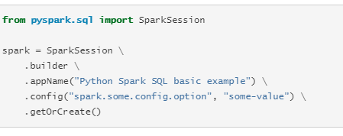
Starting Point: SparkSession
The entry point into all functionality in Spark is the SparkSession class
To create a basic SparkSession, just use SparkSession.builder

Slide 6
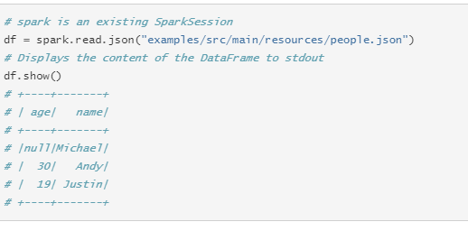
Creating DataFrames
With a SparkSession, applications can create DataFrames from
an existing RDD
from a Hive table
from Spark data sources
Following creates a DataFrame based on the content of a JSON file

Slide 7
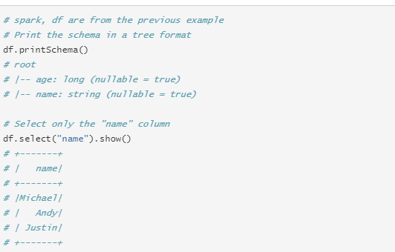
DataFrame Operations
Untyped Dataset Operations
DataFrames provide a domain-specific language for structured data manipulation
Scala, Java, Python and R
DataFrames are just Dataset of Rows in Scala and Java API
These operations are also referred as “untyped transformations” in contrast to “typed transformations” come with strongly typed Scala/Java Datasets
Some basic examples of structured data processing:

Slide 8
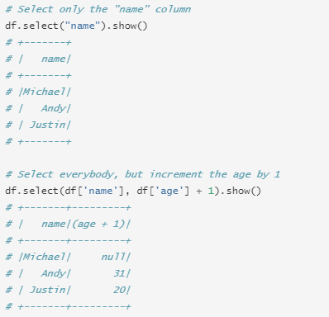
DataFrame Operations (2)
More Examples

Slide 9
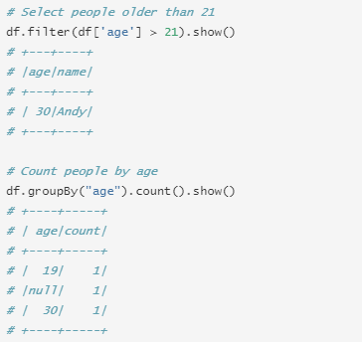
DataFrame Operations (3)
More Examples

Slide 10
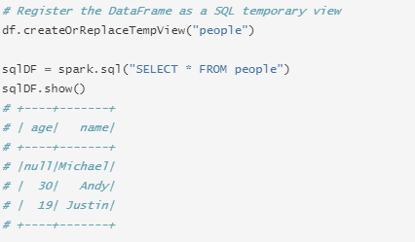
Running SQL Queries Programmatically
The sql function on a SparkSession enables applications to run SQL queries programmatically and returns the result as a DataFrame.

Slide 11
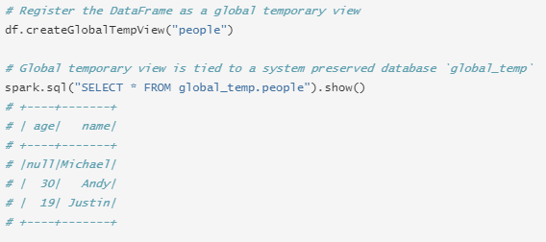
Global Temporary View
Temporary views in Spark SQL are session-scoped
will disappear if the session that creates it terminates
If you want to have a temporary view that is shared among all sessions and keep alive until the Spark application terminates
can create a global temporary view
Global temporary view is tied to a system preserved database global_temp
must use the qualified name to refer it, e.g. SELECT * FROM global_temp.view1

Slide 12
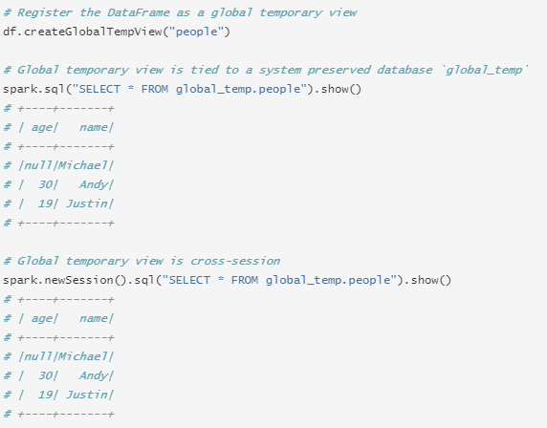
Global Temporary View (2)
Across sessions

Slide 13
Thank You!
Reference :
Opensource Article by Dipanjan Sarkar
Spark Documentation
In our next session: Spark SQL - Dataset

